Slide 2
X-ray Dataframe visualization
Graphic Output
Data output
Horizontal bar chart of keywords in top 5, 10, 50 ,100
Pie chart of categories in top 5, 10, 50 ,100
Histogram of price in all, Ratings histogram in top 10, 50, 100 + scatter plot
Review count histogram in top 10, 50, 100 + scatter plot
Review velocity -> review rate = sales/velocity scatter plot + histogram
Dimensions -> volume histogram in top 10, 50, 100 + scatter plot
Size Tier pie chart in all
Image number histogram in top 10, 50, 100
Listing Creating Date -> Date on Amazon, histogram in top 10, 50, 100 + scatter plot
Dataframe of keywords occurance in top 5, 10, 50, 100
Price average, stdev, min, max
Ratings average, stdev, min, max in top 5, 10, 50, 100
Volume average, stdev, min, max
Weight average, stdev, min, max
Size Tier change to numerical
Date on Amazon average, stdev, min, max in top 10, 50, 100 + scatter plot

Slide 3
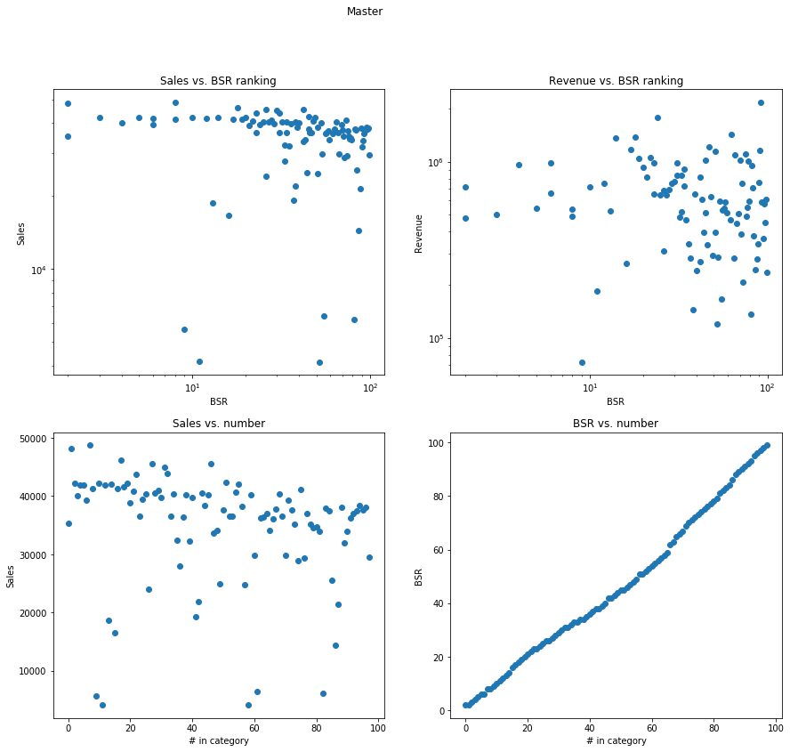

Slide 4
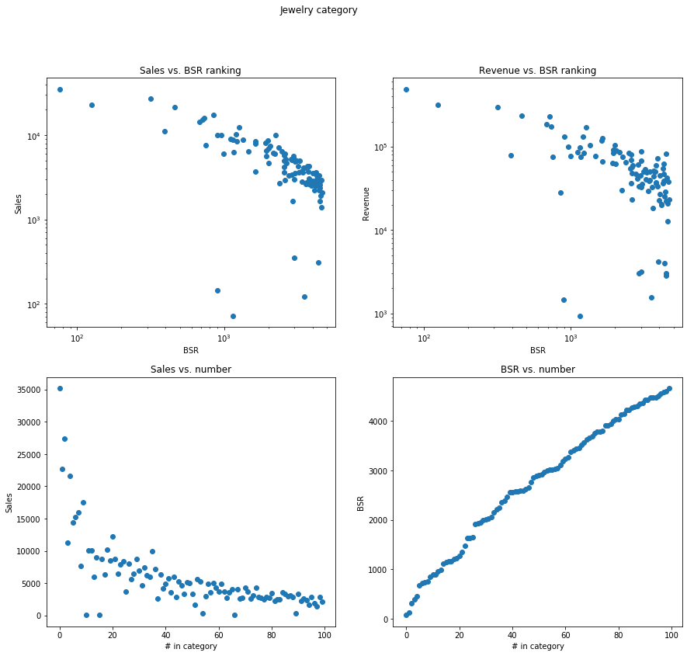

Slide 5
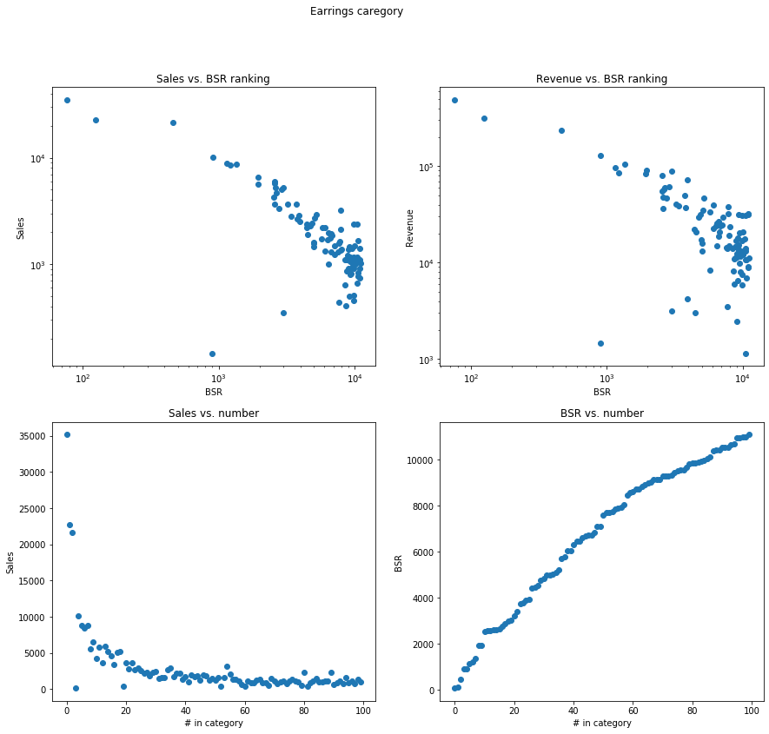

Slide 6
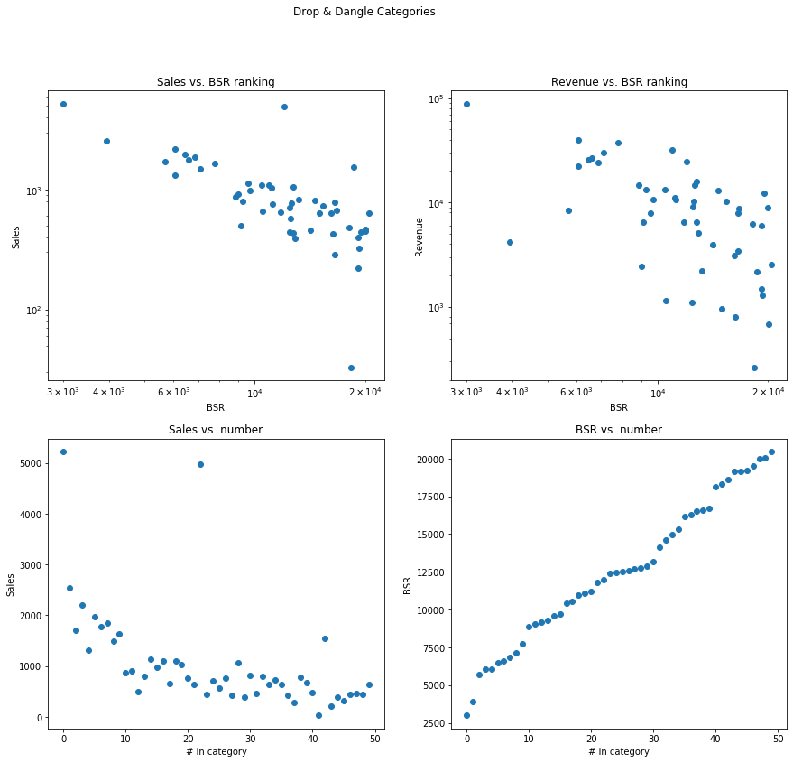

Slide 7
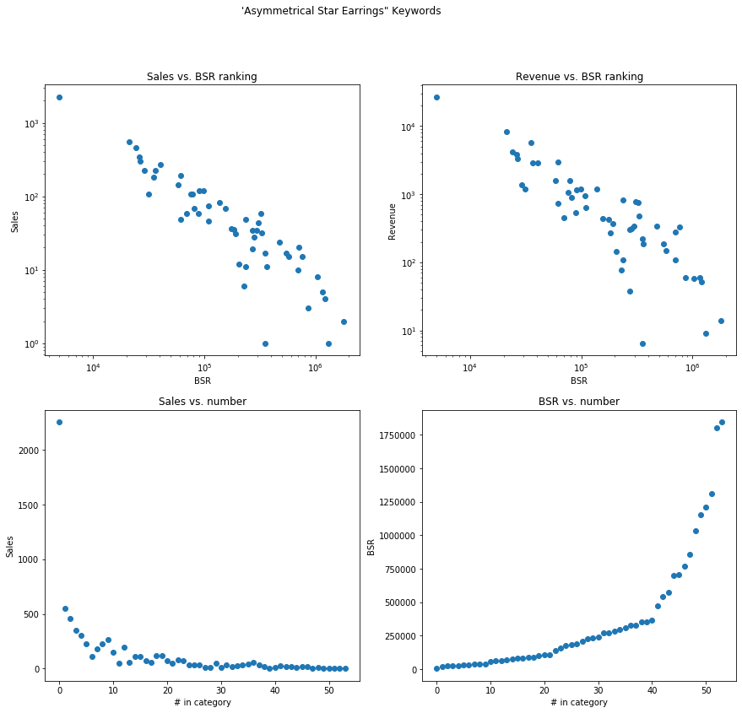

Slide 8
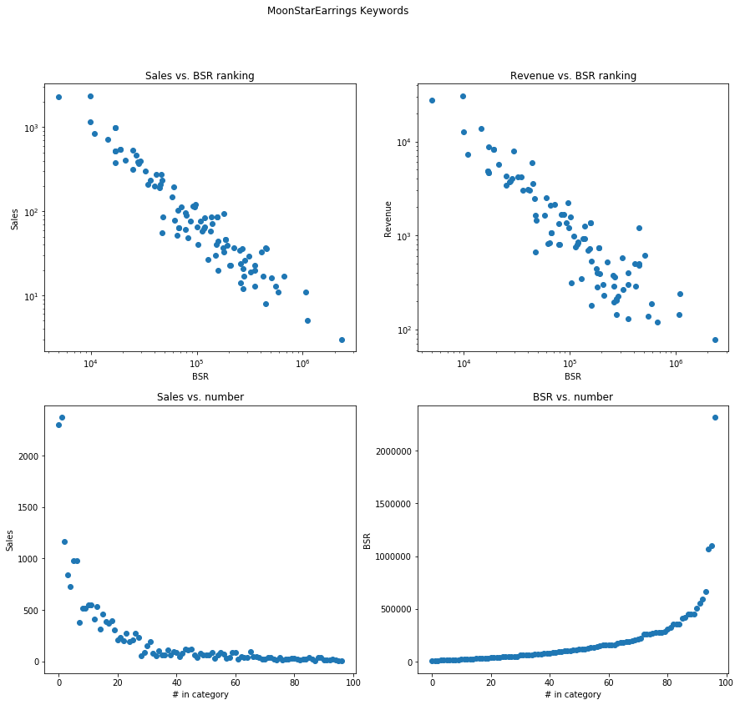

Slide 9
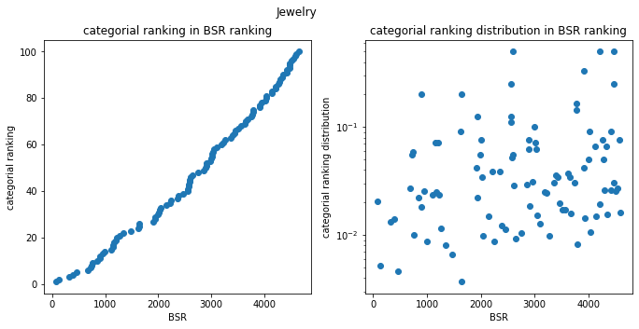
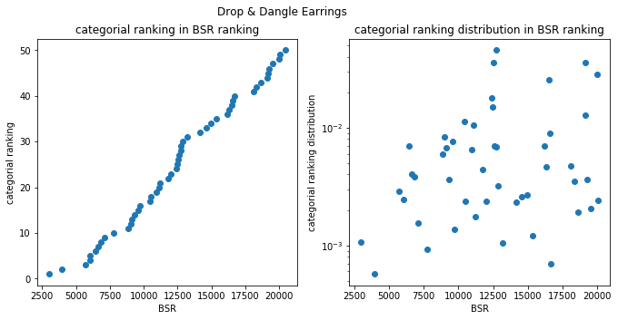
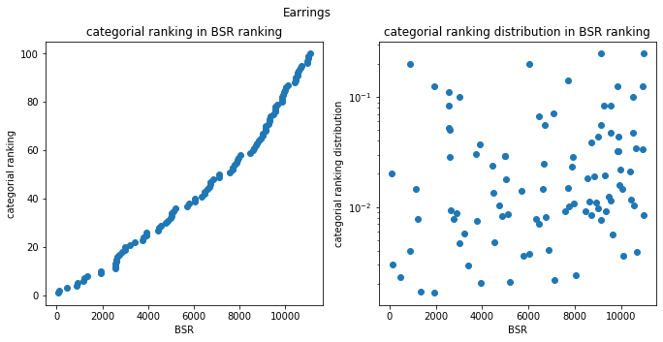
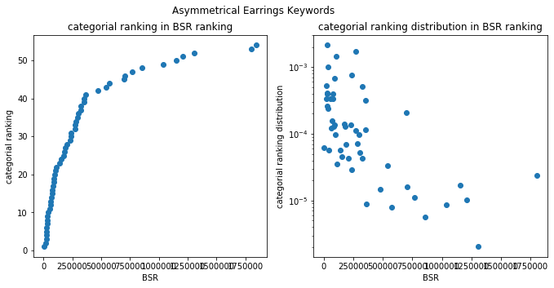

Slide 10
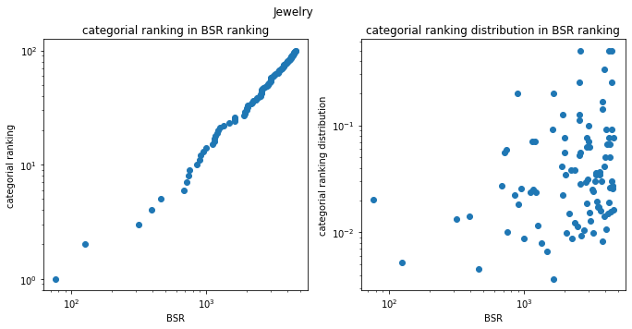
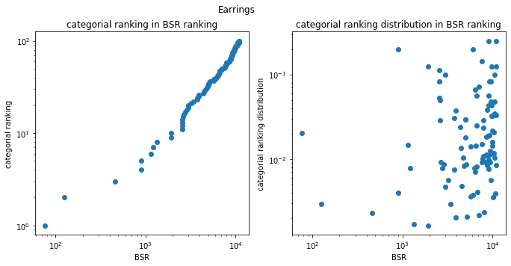
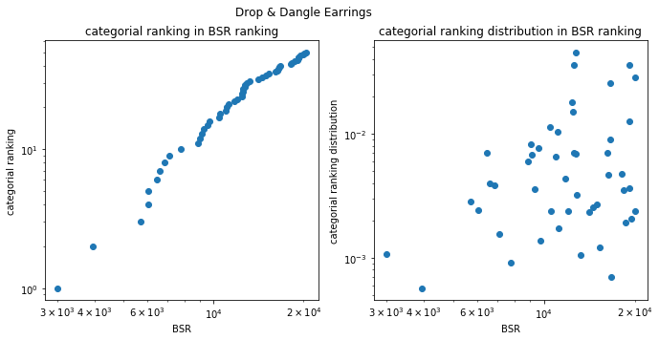
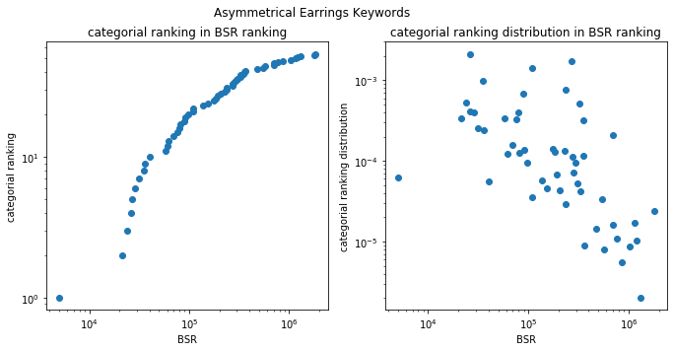

Slide 11
Sales vs. ranking fitting
Model | Avg. R2 score | clothing, shoes, jewelry BSR R2 score
Lorentz | 0.568 | 0.893
Gaussian | 0.500 | 0.877
Inverse polynomial | 0.688 | -25871.49

Slide 12
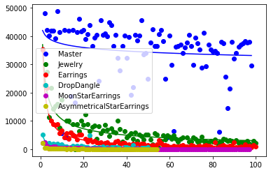
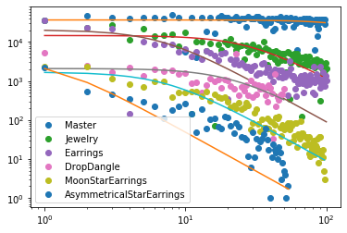
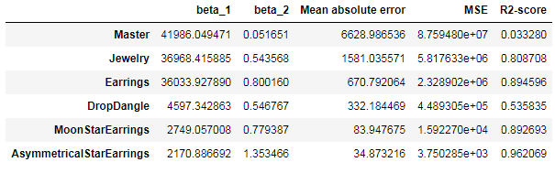
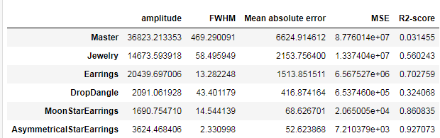
Sales vs. ranking fitting
Inverse polynomial Fitting
Lorentz Fitting

Slide 13
Categorial data
Cat_cat_relat
Top 10 sales
Top 10 revenue
Top 10 sales percentage
Top 50 sales
Top 50 revenue
Top 50 sales percentage
Top 100 sales
Top 100 revenue
Top 100 sales percentage
Top 10 ranking top n in the other category
Top 10 count for percentage of sales in other category
Top 50 ranking top n in the other category
Top 50 count for percentage of sales in other category
Top 100 ranking top n in the other category
Top 100 count for percentage of sales in other category

Slide 14
Testing a product in a category
Product in a category
Ranking in the category
Percentile in all sellers

